Slide 1
Introduction
Panel Data Models
Part 1
BUAN / MECO 6312
Dr. Moran Blueshtein
University of Texas - Dallas

Slide 2
Introduction
A panel of data consists of a group of cross-sectional units (people, households, firms, states, countries) who are observed over time.
Denote the number of cross-sectional units (entities) by N
Denote the number of time periods in which we observe them as T
We typically have N>>T

Slide 3
Introduction
Note:
In panel data we follow the same entities over time.
We may collect several samples from a population at several points in time, but the entities are not the same in each time period.
This is NOT panel data.

Slide 4
Introduction
In panels, the entities are not always observed the same number of times.
Balanced panel - each entity has the same number of observations.
Unbalanced panel - number of time series observations is different across entities.

Slide 5
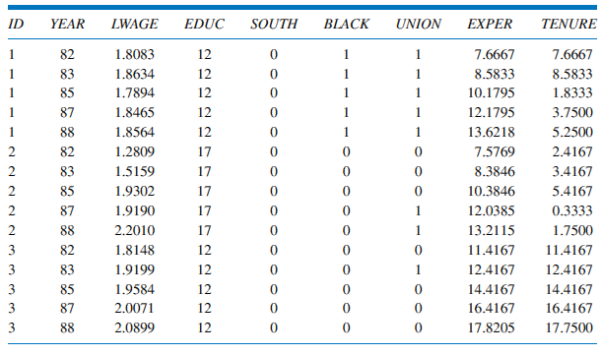
Introduction
Example – Balanced Panel

Slide 6
Pooled OLS

Slide 7
Pooled Model
The data on different individuals are simply pooled together.
Note that the coefficients (β₁, β₂, β₃) are common to all i and t.
The equation is estimated using least squares.
The least squares estimator, when applied to panel data model, is referred to as pooled least squares

Slide 8
Pooled Model
Pooled Least Squares Estimates of (ln) Wage Equation

Slide 9
Pooled Model
7% return to an extra year of education.
Overall market experience and job tenure have positive but diminishing effects on ln(wage).
Wages are 12% lower for black workers.
Wages are 11% lower for workers in the South.
Unionized workers enjoy wages that are 13% higher.

Slide 10
Pooled Model
Pooled Least Squares and Model Assumptions
Does pooled model satisfy the basic assumptions?

Slide 11
Pooled Model
Assuming lack of correlation between errors corresponding to the same individual is not sensible….
Unobservable characteristics that are included in the error term are likely to be correlated for the same individual.
If for a given level of observable characteristics individual’s wage is higher than average in one year, due for example to higher than average ability or talent, it is also likely that the wage will be higher than average in other years.
Assumption 3 is violated!

Slide 12
Pooled Model
We have to relax the assumption of zero error correlation over time for the same individual.
We continue to assume that the errors for different individuals are uncorrelated (reasonable as individuals constitute a random sample)

Slide 13
Pooled Model
Variance may also be different in different time periods.
Assumption 2 may be violated as well:

Slide 14
Pooled Model
The Consequences of Violating Basic Model Assumptions
Suppose that we proceed with least squares estimation without recognizing the existence of serially correlated errors and heteroskedasticty. What are the consequences?
The least squares estimator is still a linear unbiased and consistent estimator, but it is no longer best (efficient).
The formulas for the standard errors usually computed for the least squares estimator are no longer correct
Confidence intervals and hypothesis tests that use these standard errors will be misleading

Slide 15
Pooled Model
Cluster-Robust Standard Errors
It is possible to compute correct standard errors for the least squares estimator.
These are called Panel-Robust Standard Errors or Cluster Robust Standard Errors.
With cluster robust standard errors S.E are correct, even though the estimator is still not BEST (not efficient).

Slide 16
Pooled Model
Consider the model y_{t} = β₁ + β₂x_{t} + e_{t}
The variance of b₂ is:
where

Slide 17
Pooled Model
Cluster robust SE are related to heteroskedasticity-consistent (or the White-Robust) SE.
When the errors are not correlated, cov(e_{t}, e_{s}) = 0, and the term in square brackets is equal to one.
The resulting expression
is the one used to find heteroskedasticity-consistent (White/Robust) standard errors

Slide 18
Pooled Model
Cluster-Robust Standard Errors

Slide 19
Pooled Model
With cluster robust standard errors, standard errors will be typically bigger, and t-values are lower than when we don’t use robust S.E.

Slide 20
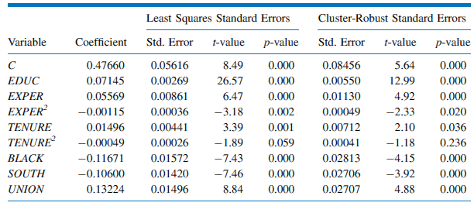
Pooled Model
Pooled Least Squares Estimates of Wage Equation
Large differences between S.E imply that there are individual characteristics that are not completely captured by the included explanatory variables that are correlated over time.
Ignoring the within-individual correlation means that the reliability of the pooled OLS estimates is overstated.
When using pooled OLS always use Cluster Robust S.E.

